Slide 1
DATT 3700 Collaborative Project Development
Winter 2022
1. Intro

Slide 2
Hello
Dafydd Hughes
Tuesday: Lecture 1:30pm, Lab 1 2:30pm
Jane Tingley
Thursday: Lecture 1:30pm, Lab 1 2:30pm
Grace Grothaus
Tuesday & Thursday: Lab 2 4:30pm

Slide 3
Course description
In this course students will develop skills for how to work effectively on teams. This course will guide students through a number of teamwork exercises and methodologies, including Agile, Scrum, guided reflection, team worksheets, written reflection, surveys, games and other relevant activities. Students will learn how to structure and develop team vision, task management, effectively communicate abstract concepts, and to maintain empathy for fellow teammates. Students will work in teams to produce creative works and will analyse ‘how’ the work was accomplished, in order to develop strategies for the next stage of project development. This course will require ongoing critical reflection, observation and analysis, and cyclical review, to allow students to iteratively develop their ability to work in teams. The final creative works will be presented to the public during the final student showcase.

Slide 4
The plan
Two project cycles, separated by Reading Week
1 | Intro
2 | Learn
3 | Ideate
4 | Create
5
6 | Critique
7 | Ideate
8
9 | Create
10
11
12 | Critique

Slide 5
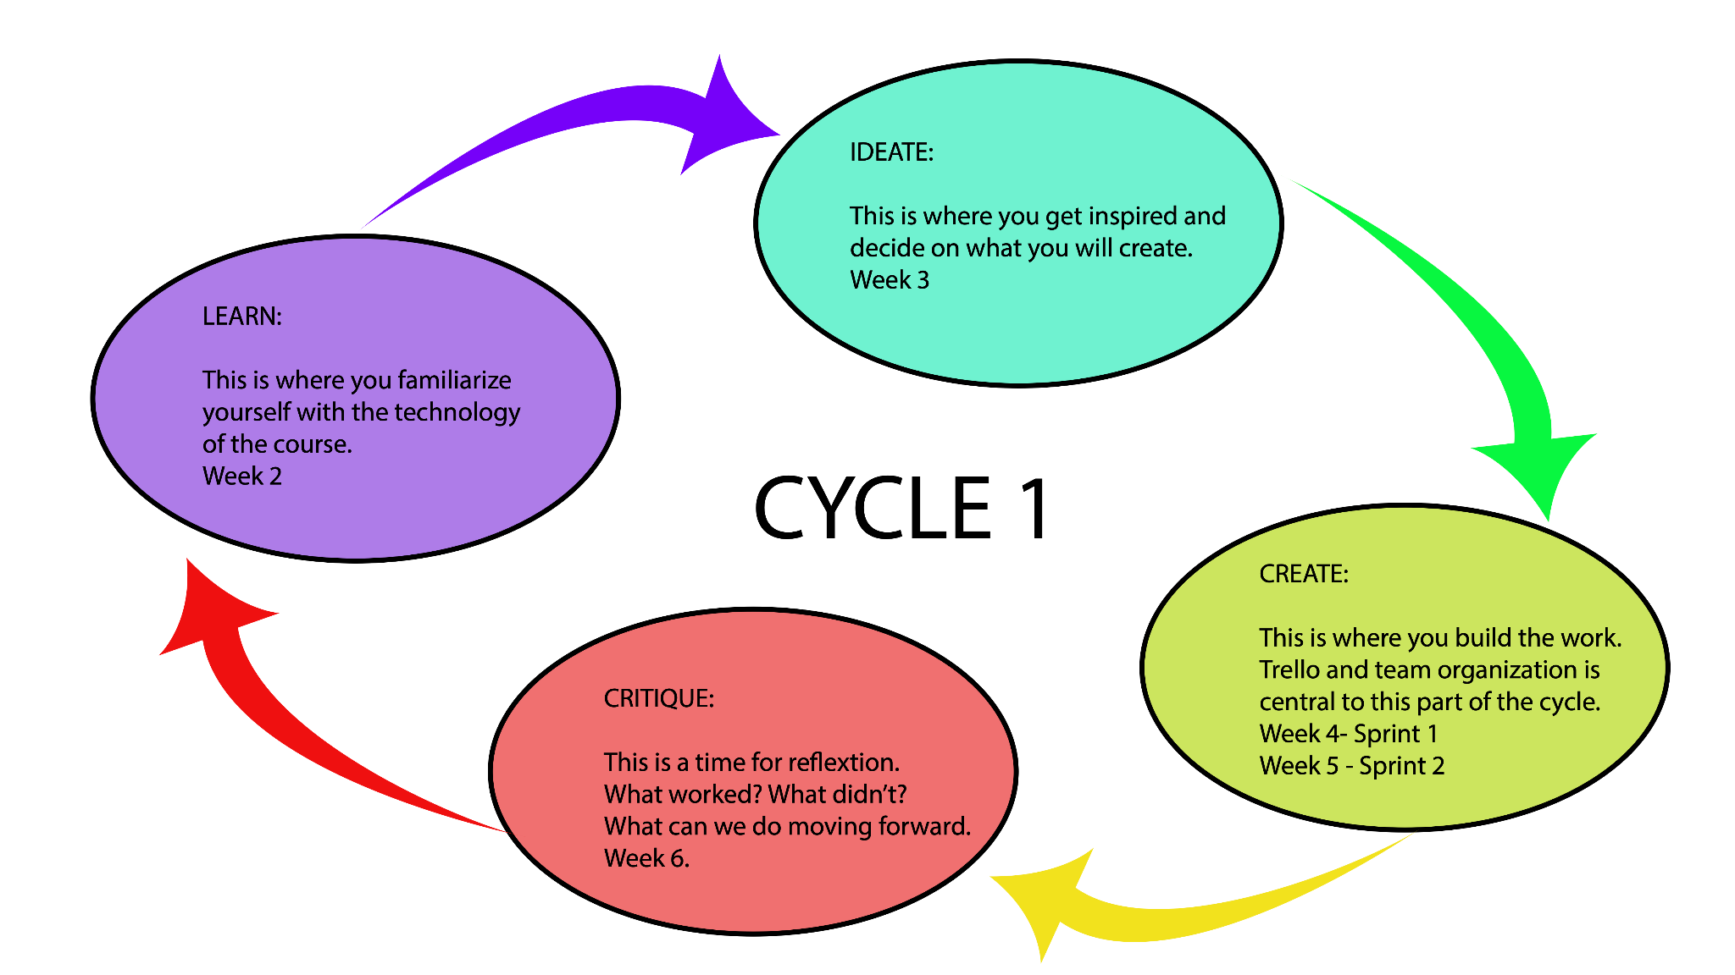

Slide 6
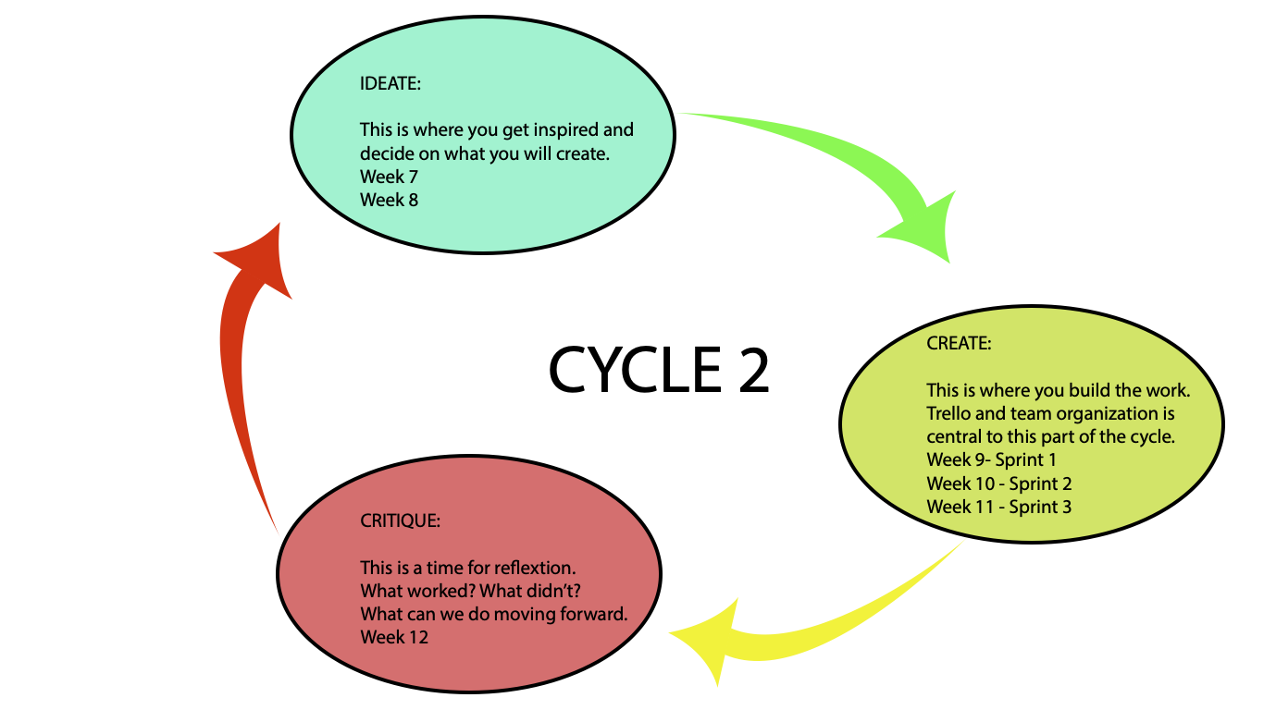

Slide 7
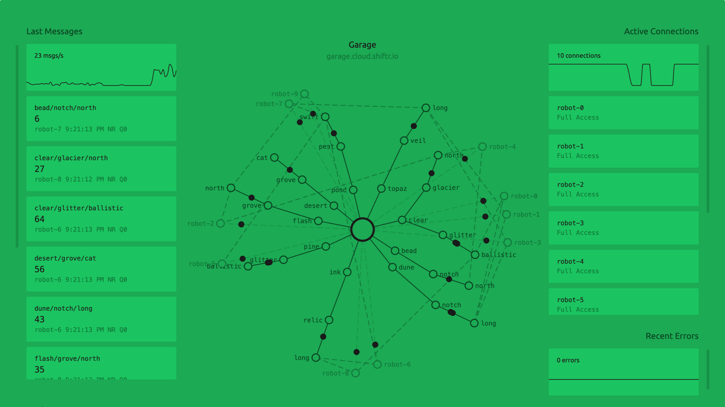
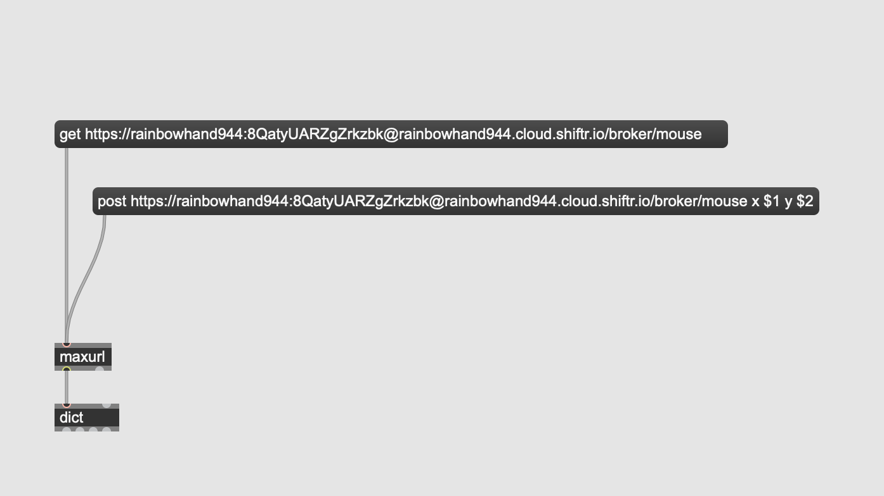
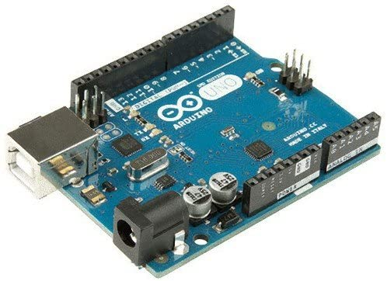
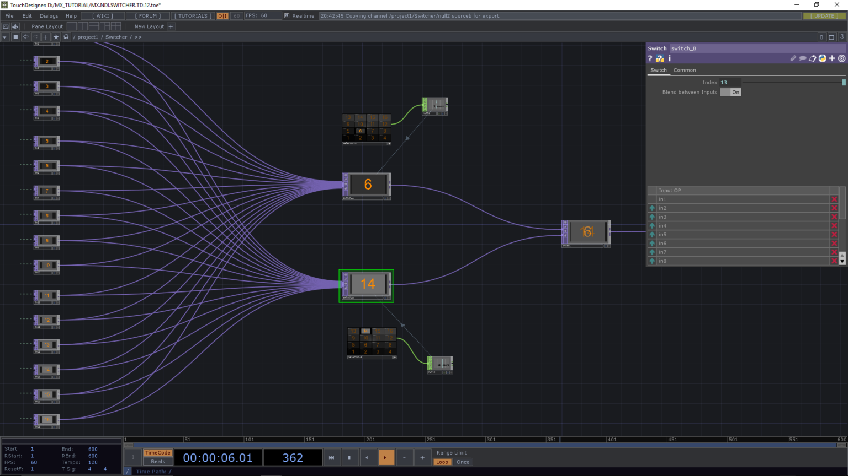
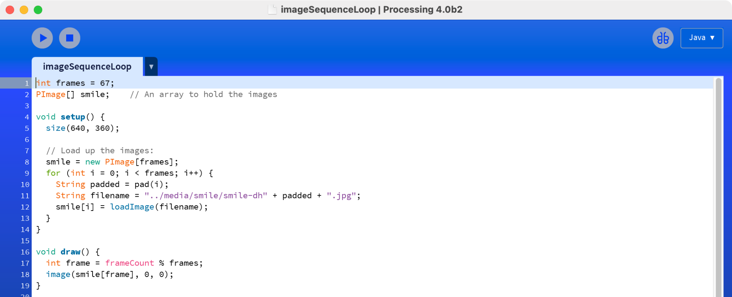
Technologies
shiftr.io
Max/MSP
Arduino
TouchDesigner
Processing

Slide 8
eClass
Syllabus
Evaluation
Resources
Weekly content

Slide 9
Tools and Processes

Slide 10
Labs

